Slide 1
Operating Systems
Dr. Deepak Dembla

Slide 2
Protection Mechanisms

Slide 3
Objectives
Protection domains
Access control mechanisms
Access control lists
Capability lists
Cryptography as a security tool
Authentications and its methods
Intrusion detection system
Worm/bot/Rootkit countermeasures
Dealing with buffer overflow attacks
Dealing with mobile code
Security patches
Secure file systems
Trusted operating systems

Slide 4
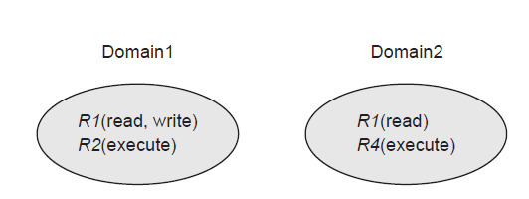
Protection Domains
A domain is a set of object and right pairs.
Protection domains: a resource in multiple domains

Slide 5
Access Control
The access control policies are grouped into the three following categories:
Discretionary access control (DAC)
Mandatory access control (MAC)
Role-based access control (RBAC)
The matrix containing the information of access rights of the resources within a domain is known as access matrix.

Slide 6
Access Control
Storing only non-empty entries as access rights for objects is known as access control lists(ACL). Each column is then implemented as an ACL in the access matrix. The advantage of an ACL is that it reduces the space storage and increases the search efficiency as well.
A capability list for a domain is a list of objects with their allowed operations that the domain can have.

Slide 7
Access Matrix
Domain/Object | File A | File B | Printer1 | Printer2
Domain1 | Read
Domain2 | Read Write |  | print
Domain3 |  | Read Write execute |  | print

Slide 8
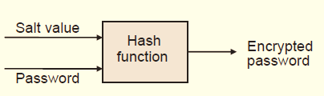
Authentication
Passwords are widely used authentication mechanisms against unauthorized users.
Authentication using hash-encrypted password method is secure against a lot of security attacks.
Hash-encrypted password

Slide 9
Intrusion Detection System
Intrusion Detection System (IDS) is a security service that may be used along with other security suite such as a firewall and a good antivirus.
There are two types of Intrusion Detection Systems:
Host-Based IDS
Network-based IDS

Slide 10
Worm/Bot/RootKit counterMeasures
Worms can be detected based on the signature of a worm. The technique generates the signatures of worms. Using these signatures only, worms entry/exit are detected.
Another way to stop worms is the network filtering.
An effective method to check the presence of a rootkit on the system is to boot it from a trusted and clean operating system source and scan the system.
The rootkit at this time is not active and therefore can be checked for its existence.

Slide 11
Dealing with Buffer Overflow Attacks
Various ways to deal with buffer overflow attacks are:
Writing Correct Code
Safe Libraries
Use of type-safe programming language
Non-executable Buffers
Address space randomization

Slide 12
Dealing with Mobile Code
Various ways to deal with mobile code are:
Code blocking approach
Authentication using code signing
Safe Interpreters
Code inspection
Sandboxing
Proof-carrying code (PCC)

Slide 13
Trusted Operating Systems
A trusted system is the system that has formally stated security requirements and meets these requirements.
To design a trusted operating system, a security kernel is designed such that it provides the security interfaces among the hardware, operating system, and other parts of the system.

Slide 14
Trusted Operating Systems
The security kernel is designed on the top of hardware. It monitors all operating system hardware accesses and checks any illegal access and thereby performing all protection functions
To enforce the security policy, there is a trusted computing base (TCB) acting as a shell that protects whatever in the system needs protection.

Slide 15
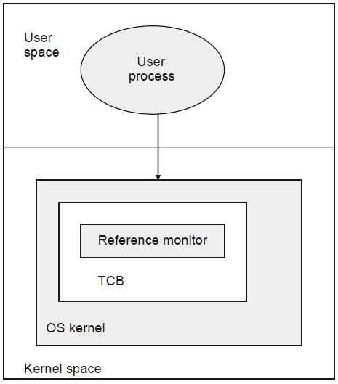
Trusted Computing Base

Slide 16
Multilevel Security Models
There are two types of security models:
Bell-La Padula Security Model (BLP Model)
It is a formal description of the allowable paths of information flow in a secure system.
It defines security requirements for systems that concurrently handle data at different sensitivity levels.
The BLP addresses confidentiality.
Biba Model
The Biba model addresses integrity, i.e. deals with inappropriate modification of data and therefore sometimes known as counterpart of BLP.

